Slide 1
Generative AI with Diffusion Models
Part 1: From U-Nets to Diffusion
Notes:
Hi there, and welcome to Generative AI with Diffusion Models.

Slide 2
Agenda
• | Part 1: From U-Nets to Diffusion
• | Part 2: Denoising Diffusion Probabilistic Models
• | Part 3: Optimizations
• | Part 4: Classifier Free Diffusion
• | Part 5: CLIP
• | Part 6: Wrap-up & Assessment
Notes:
Today, we’ll start with the U-Net architecture and eventually work our way towards creating a full text-to-image pipeline.

Slide 3

Prerequisites
Basic familiarity with convolutional neural networks (CNNs)
Basic familiarity with a deep learning framework such as:
PyTorch
TensorFlow
Notes:
If you are familiar with how convolutional neural networks are built, then you have what it takes to complete this course. We will be using PyTorch. If you come from a TensorFlow background, we have provided links to the relevant PyTorch documentation to help you get up to speed quickly.

Slide 4
A Brief History of Generative AI
Notes:
To begin, let’s go over a brief history of Generative AI.

Slide 5
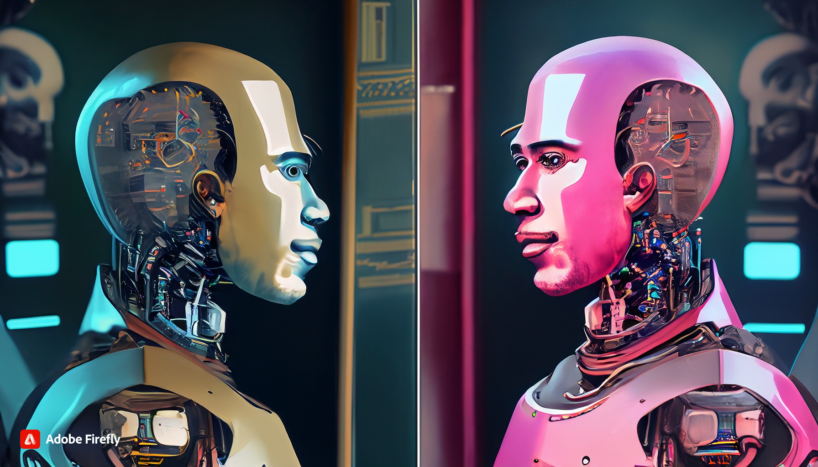
The Imitation Game
A.K.A The Turing Test
A robot looks in a mirror and the reflection is human, cyberpunk
Notes:
Throughout this course, we will be showcasing images generated by Adobe Firefly. Beside each image that was generated, we provide the prompt used to create it.
In the 1950’s Alan Turing proposed a question, “Can machines think?” Since the definition of consciousness is difficult to define, he then proposed a test: could a machine imitate a human well enough that a human did not know it was a machine? He called this test, the Imitation Game.

Slide 6
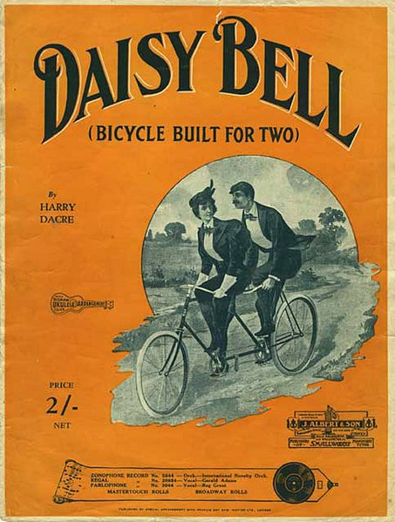
IBM 704
The First Singing Computer
Notes:
About ten years later in 1961, researchers were attempting to emulate various instruments with electronic sound. Of these instruments, the human voice was one of the most difficult to replicate. The IBM 704 is considered the first machine to synthesize human singing. If you’re a fan of sci-fi and wonder why computers often sing about daisies, that’s because the first song sung by a computer is “Daisy Bell”.

Slide 7
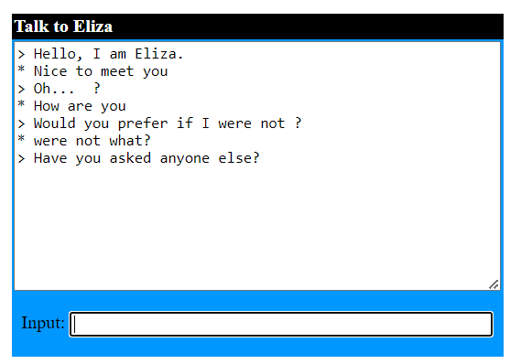
Eliza
The First Gen AI Chatbot?
Notes:
Around the same time, Eliza was created to replicate the questioning of a psychologist to help people talk through their problems. It was considered one of the first great successes of natural language processing. Eliza was created by Joseph Weizenbaum , and the JavaScript version here was created by Michael Wallace and George Dunlop
If you downloaded the slides, a link to Eliza is in the instructor notes. The image here is my own conversation with Eliza.
https://psych.fullerton.edu/mbirnbaum/psych101/eliza.htm

Slide 8
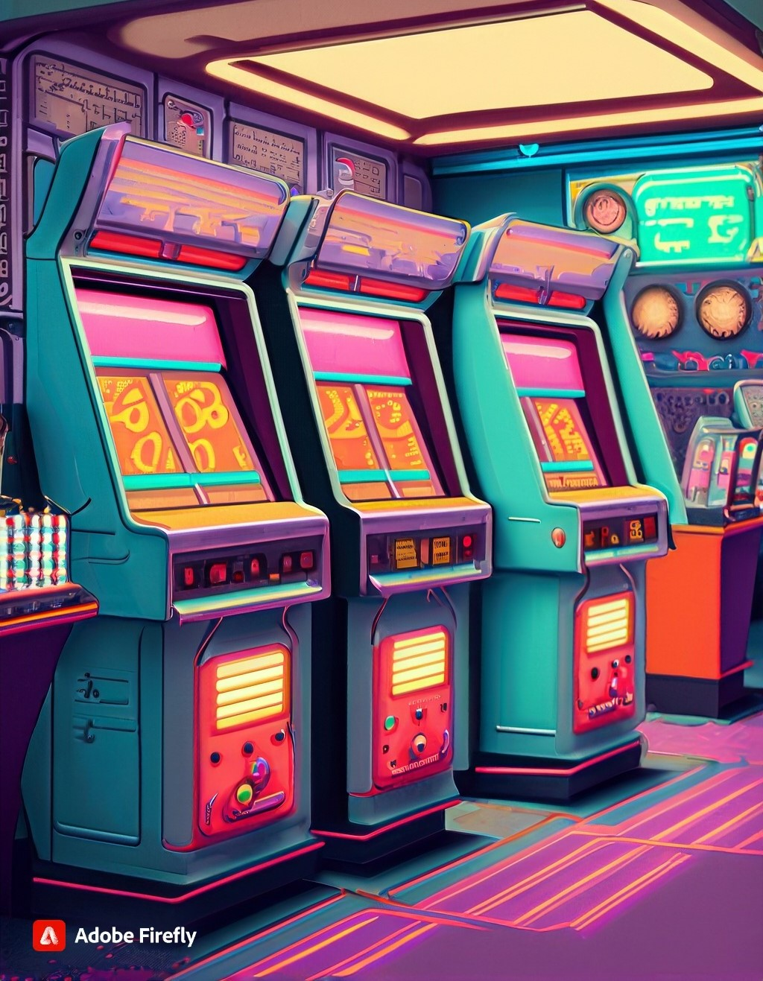
Generative AI of the 70’s, 80’s and 90s?
Electronic music
Video games graphics
Video game AI
Computer animation
Instant messaging chatbots
An 80’s arcade with lots of machines
Notes:
After Eliza’s era, the generative AI field was considered dormant for many years. However, many advancements in computer technology gave rise to the AI we have today. It became easier to digitally create and store music. Videogames were a playground to test how a computer could respond to human input. Computer graphics helped speed up hand animation or gave some films a sci-fi feel. When instant messaging became a thing, smarter and smarter chatbots were developed.
Even though computers weren’t thinking in the way that Turing suggested, people increasingly interacted with computers.
What were some of your favorite technological advancements that paved the way for what we have now?

Slide 9
The Rise of Neural Networks
Notes:
With the rise of Neural Networks in the past decade, we’ve seen an explosion of Generative AI applications.

Slide 10
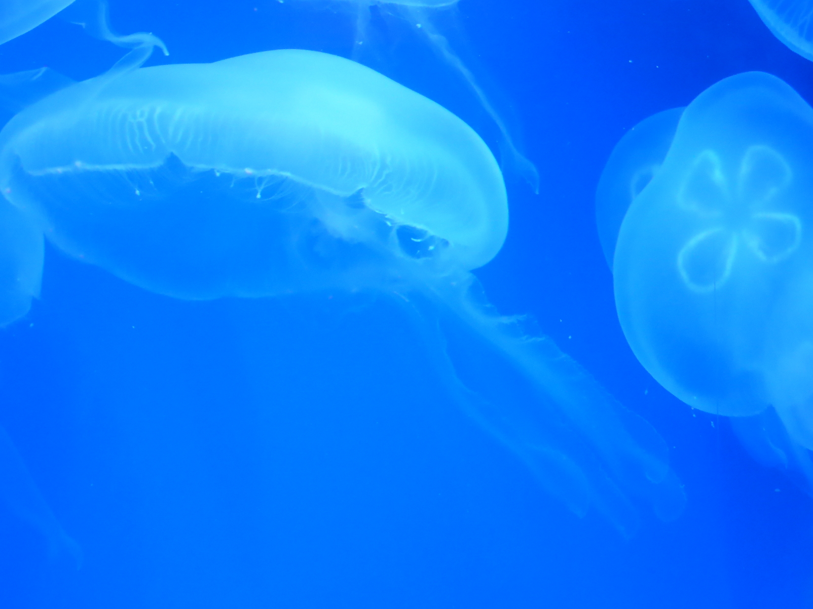
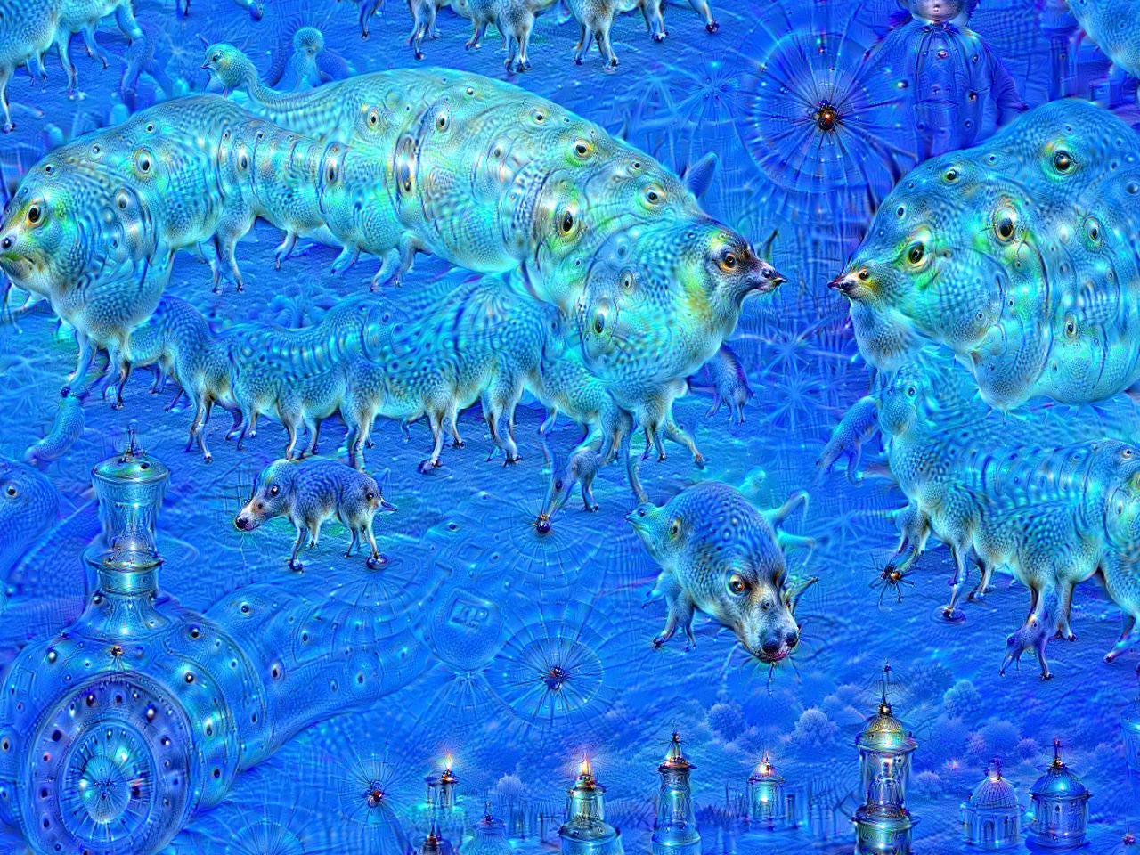
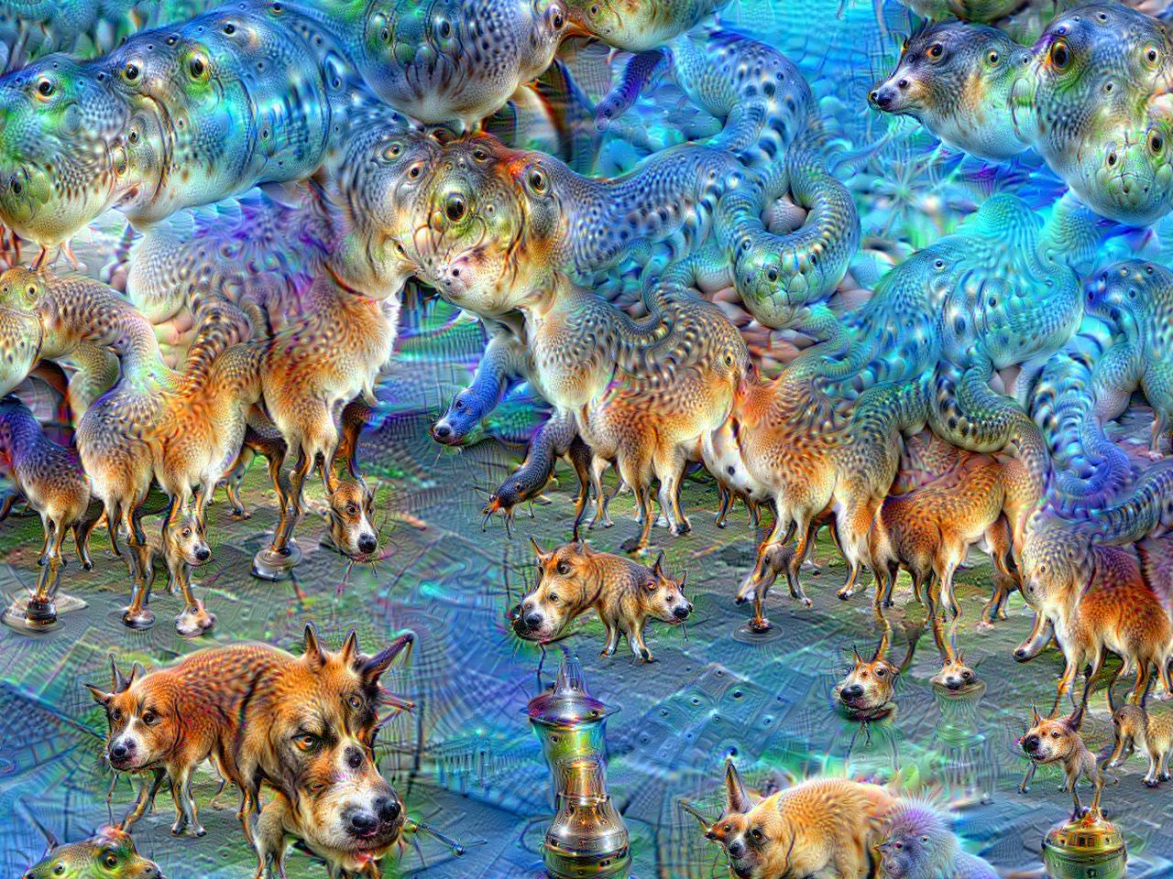
Deep Dreaming
Images by Martin Thoma
Original
10 Iterations
50 Iterations
Notes:
One of the first neural network applications to create AI art was “Deep Dreaming”. A Google engineer by the name of Alexander Mordvintsev realized he could run ImageNet “backwards” on an image to exaggerate features that ImageNet learned to classify. Because at the time, ImageNet was trained with many dog and animal photos, it tended to exaggerate dogs and animals.
This is similar to the psychology phenomenon Pareidolia. Or if you’re a gamer, the Tetris Effect.
https://en.wikipedia.org/wiki/DeepDream#/media/File:Aurelia-aurita-3_(cropped).jpg
https://en.wikipedia.org/wiki/DeepDream#/media/File:Aurelia-aurita-3-0009.jpg
https://en.wikipedia.org/wiki/DeepDream#/media/File:Aurelia-aurita-3-0049.jpg

Slide 11
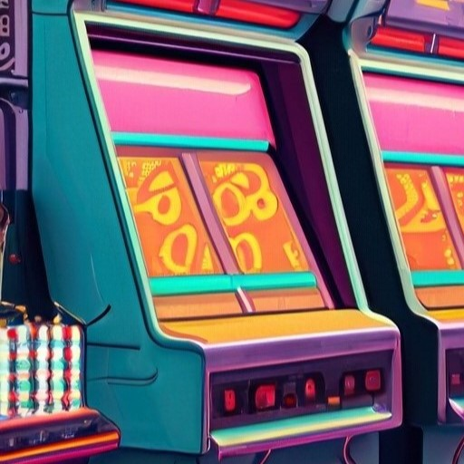
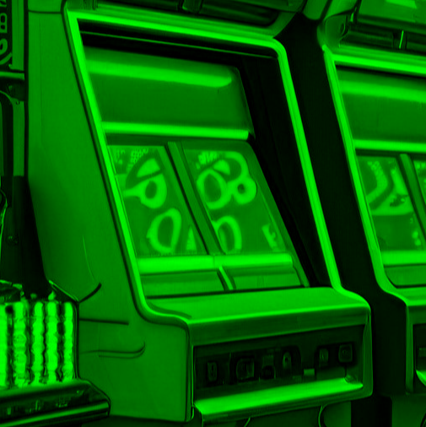
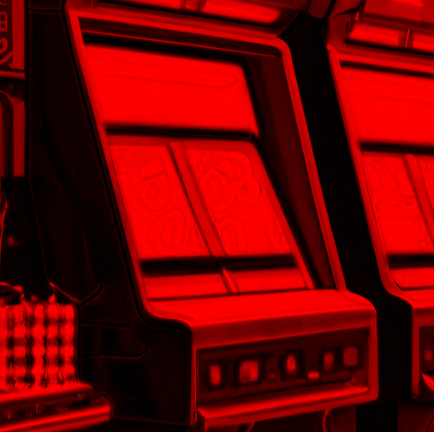
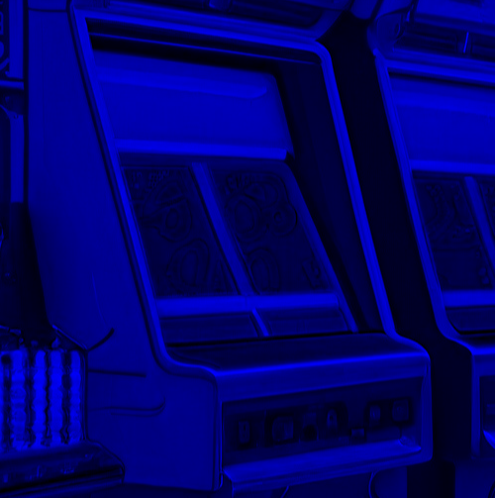
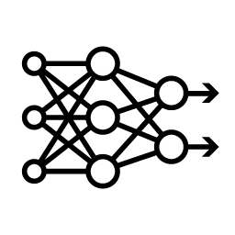
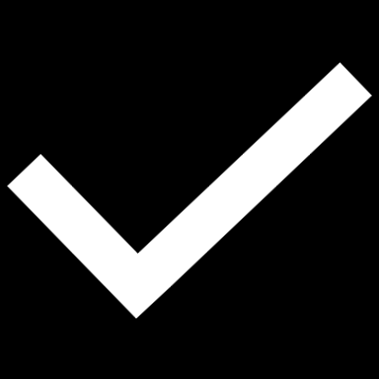

GANs
Generative Adversarial Networks
Discrimination Network
[0.1, -.2, … 0.9]
Real
Feature Map
CNN
Down
Block
CNN
Down
Block
Feature Map
Fake
DNN
Flatten
Convolution
Normalization
Activation Function
Pooling
Notes:
Soon after Deep Dreaming, the GAN architecture was invented by Ian Goodfellow and colleagues.
Here’s the idea: we’re going to create two neural networks. We’ll call the first network the “Discriminator”. The Discriminator is a typical convolutional neural network that has one job: it’s trying to figure out if the image fed into it is a real photo, or a generated one. We’ll call the output of each convolution block a “Feature Map”. This is a result of the input image after it has been convolved and pooled.
If we feed it our generated arcade cabinet to the discriminator, it will flag a fake.

Slide 12
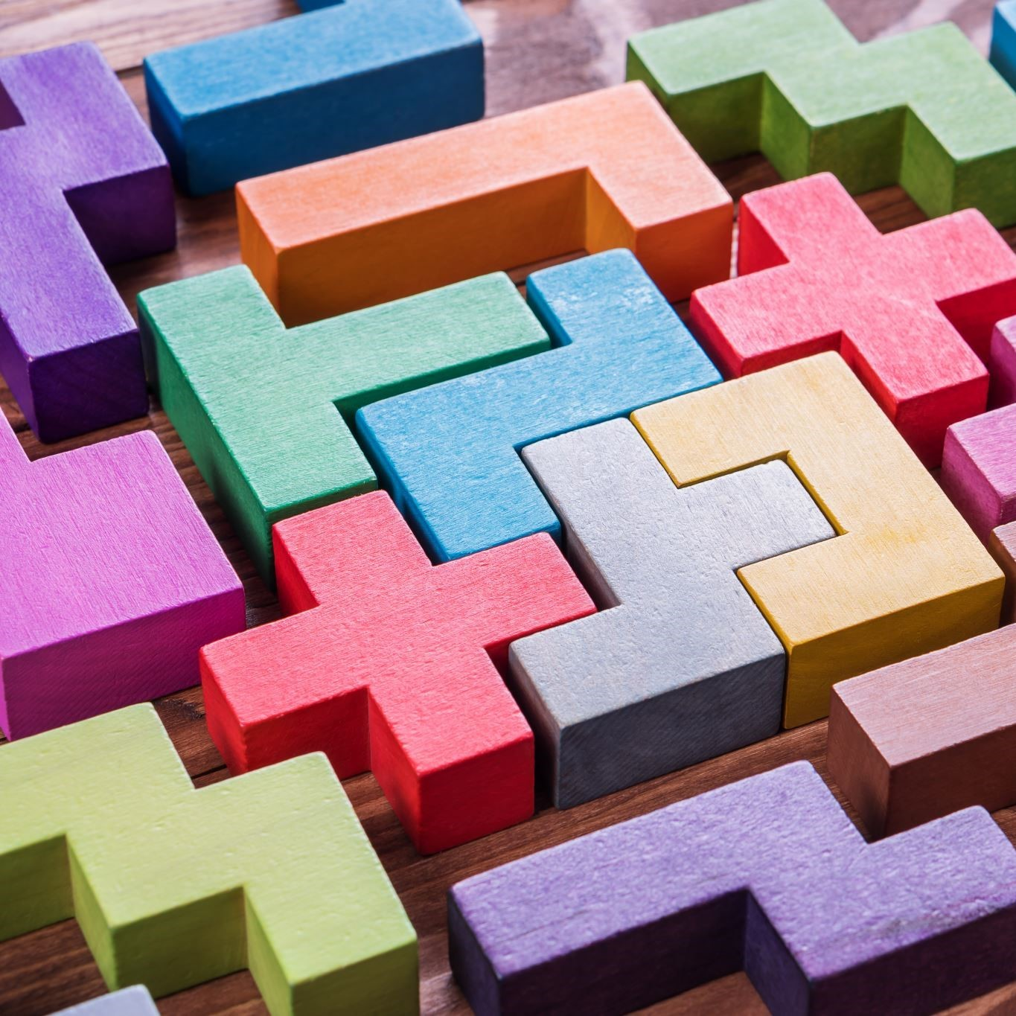
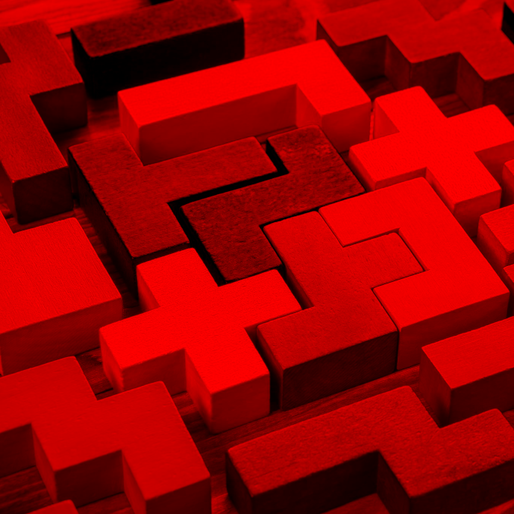
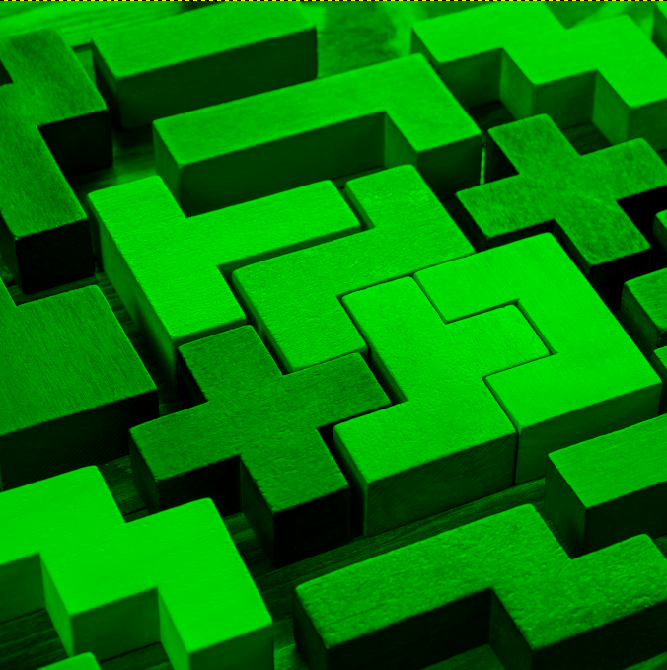
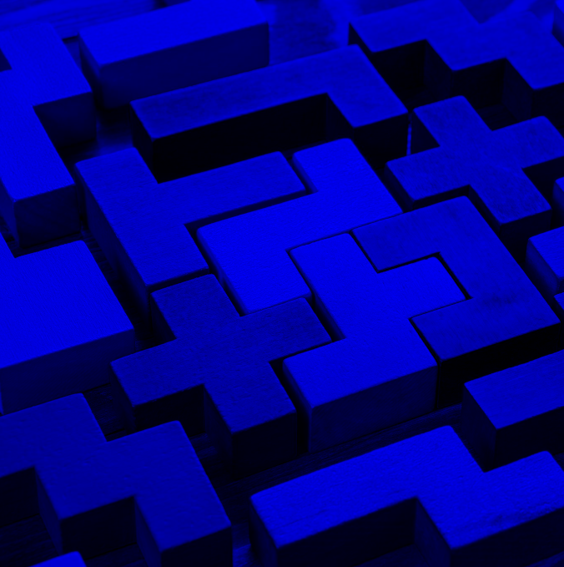
GANs
Generative Adversarial Networks
Discrimination Network
[0.1, -.2, … 0.9]
Real
Feature Map
CNN
Down
Block
CNN
Down
Block
Feature Map
Fake
DNN
Flatten
Notes:
If we feed it this stock photo of pentominoes, it will flag as real.

Slide 13
GANs
Generative Adversarial Networks
Discrimination Network
[0.1, -.2, … 0.9]
Real
Feature Map
CNN
Down
Block
CNN
Down
Block
Feature Map
Fake
DNN
Flatten
Generation Network
[0.2, -.8, … -0.1]
Feature Map
Add to Discriminator Dataset
CT
Up
Block
Feature Map
CT
Up
Block
Noise Vector
Notes:
The other network is the “Generator” network. It will create the fake images that the discriminator is trained on.

Slide 14
GANs
Generative Adversarial Networks
Normalization
Activation Function
Convolution
Normalization
Activation Function
Conv T
Generation Network
[0.2, -.8, … -0.1]
Feature Map
Add to Discriminator Dataset
CT
Up
Block
Feature Map
CT
Up
Block
Noise Vector
Notes:
The generator architecture is similar to a convolutional neural network in reverse. It does this by doing using transposed convolution. Unlike pooling which is used to reduce the height and width of a feature map, transposed convolution expands the height and width.

Slide 15
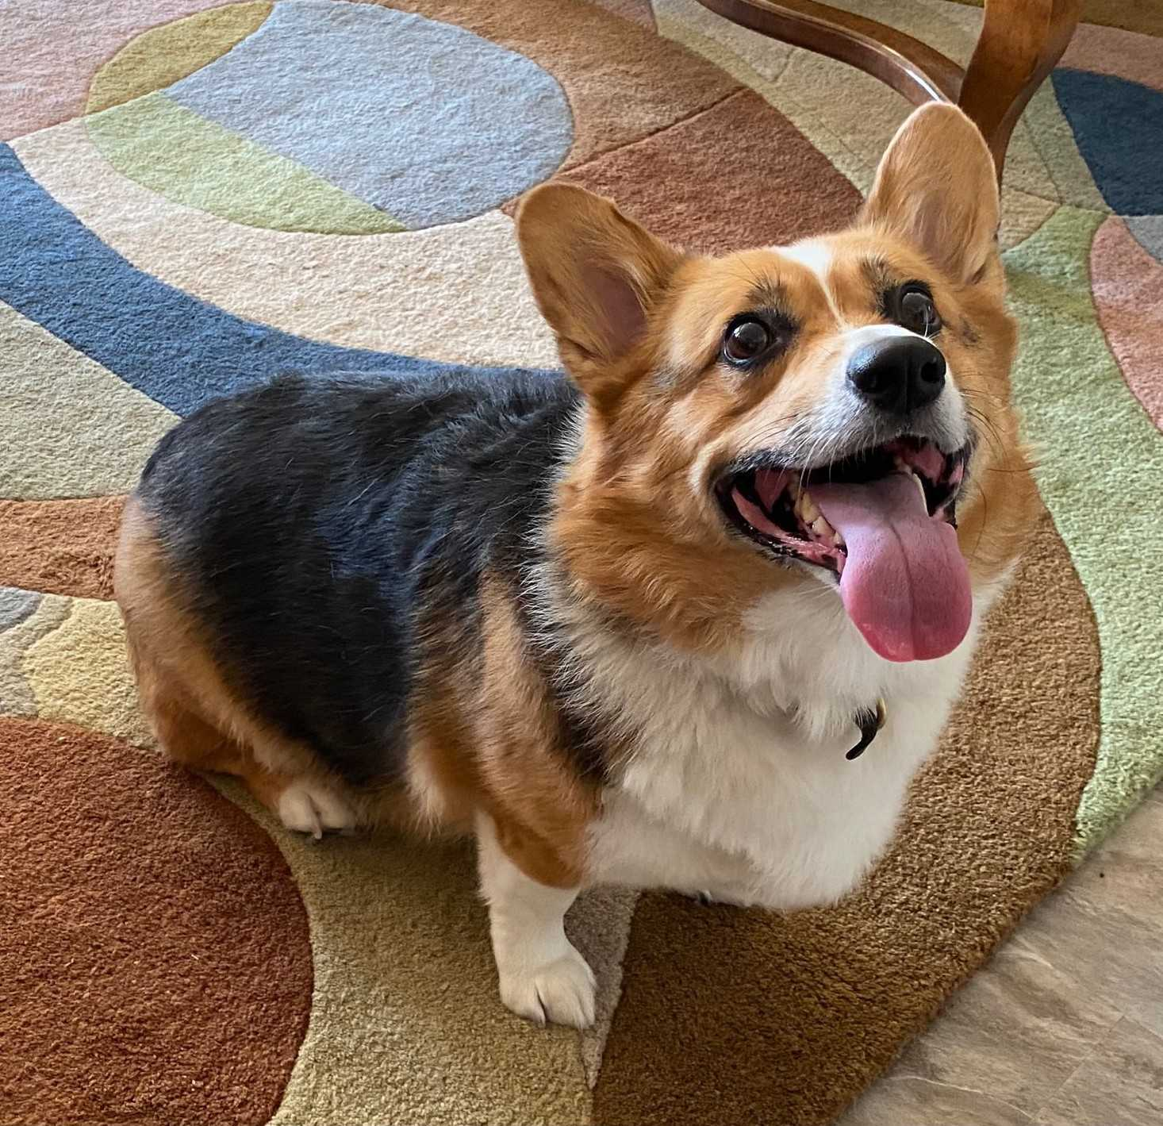
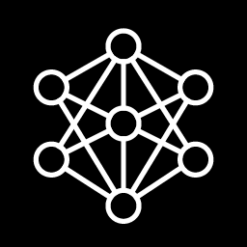
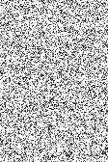
GANs
Generative Adversarial Networks
Real
Discriminator
Real Images
Fake
Generator
Noise
Fake Images
Notes:
The loss function for the generator is based on how well it “fooled” the discriminator. And the loss function for the discriminator is based on how well it avoided being fooled. Hence the phrase “adversarial”.

Slide 16

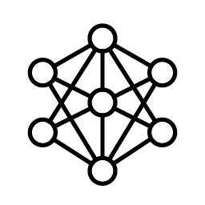
Image Segmentation
Not Corgi
Corgi
Notes:
Around the same time GANs were invented, Image Segmentation was developed for medical purposes. Could we train a neural network to detect anomalies in x-rays or ultrasounds? In more recent times, image segmentation is used with autonomous vehicles to help cars categorize pedestrians, other vehicles, or street signs. The example above is a picture of a dog, and we’ve segmented the image to separate the dog from the background.

Slide 17
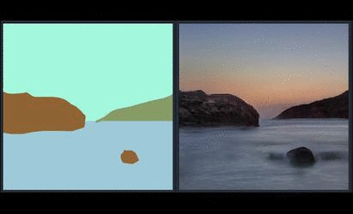
Image Segmentation + GANs
NVIDIA Spade
Notes:
If we combine the two techniques together, we can train a model to create images from segmentation maps. This is NVIDIA Spade, a precursor to NVIDIA Canvas, which is available in Omniverse.
https://github.com/NVlabs/SPADE

Slide 18
U-Nets
Notes:
Now that we’ve gone through history, let’s highly the star of today’s show: the U-Net.

Slide 19
GANs
Generative Adversarial Networks
Discrimination Network
[0.1, -.2, … 0.9]
Real
Feature Map
CNN
Down
Block
CNN
Down
Block
Feature Map
Fake
DNN
Flatten
Generation Network
[0.2, -.8, … -0.1]
Feature Map
Add to Discriminator Dataset
CT
Up
Block
Feature Map
CT
Up
Block
Noise Vector
Notes:
So what if we want to make an image based on another image? How could we do that?
We could take our GAN architecture here and …

Slide 20
GANs U-Nets
The U shaped Autoencoder
Encoder
[0.1, -.2, … 0.9]
Feature Map
CNN
Down
Block
CNN
Down
Block
Feature Map
DNN
Latent Vector
Decoder
[0.2, -.8, … -0.1]
Feature Map
CT
Up
Block
Feature Map
CT
Up
Block
Latent Vector
Notes:
Connect the output of the discriminator directly into the generator.
This would make an image autoencoder. The discriminator becomes the encoder and the discriminator becomes the decoder.

Slide 21
U-Nets
The U shaped Autoencoder
Feature Map
(Down0)
Down0
Copy
Feature Map
(Up2)
128 px
128 px
128 px
128 px
128 px
128 px
128 px
128 px
1 ch
50 ch
2 x 50 ch
3 ch
Feature Map
(Down1)
Down1 Copy
Feature Map
(Up1)
64 px
64 px
64 px
64 px
100 ch
2 x100 ch
Feature Map
(Down2)
32 px
Latent Vector
Down2 Copy
Feature Map
(Up0)
32 px
200 ch
32 px
2 x 200 ch
400 ch
32 px
200 x 32 x 32
204,800 features
Notes:
The U-Net has a special architecture for an image autoencoder. After each convolution, we will have a feature map. On the encoder side, we will take each feature map after pooling, and create a copy. On the decoder side, we’ll stack each copy with the corresponding feature map. These stacked feature maps will be inputs into a transposed convolution layer.

Slide 22
Transposed Convolution
Notes:
We have mentioned Transposed Convolution a few times, so let’s see what it’s doing on a technical level.

Slide 23
Transposed Convolution
Convolution Review
Kernel
Image
Output
1 | 0 | 1
0 | 1 | 0
1 | 0 | 1
.25 | .25
.25 | .25
Notes:
First, let’s review convolution. We have an image and a Kernel.

Slide 24
Transposed Convolution
Convolution Review
Kernel
Image
Output
1 • .25 | 0 • .25 | 1
0 • .25 | 1 • .25 | 0
1 | 0 | 1
.25 | .25
.25 | .25
.5
Notes:
And we can convolve the image by sliding the kernel along the image and multiplying the kernel values with the respective image values.

Slide 25
Transposed Convolution
Convolution Review
Kernel
Image
Output
1 | 0 • .25 | 1 • .25
0 | 1 • .25 | 0 • .25
1 | 0 | 1
.25 | .25
.25 | .25
.5 | .5

Slide 26
Transposed Convolution
Convolution Review
Kernel
Image
Output
1 | 0 | 1
0 • .25 | 1 • .25 | 0
1 • .25 | 0 • .25 | 1
.25 | .25
.25 | .25
.5 | .5
.5

Slide 27
Transposed Convolution
Convolution Review
Kernel
Image
Output
1 | 0 | 1
0 | 1 • .25 | 0 • .25
1 | 0 • .25 | 1 • .25
.25 | .25
.25 | .25
.5 | .5
.5 | .5

Slide 28
Transposed Convolution
Image Upscaling
Kernel
Image
Output
.25 | .25
.25 | .25
1 | 0 | 1
0 | 1 | 0
1 | 0 | 1
Notes:
Transposed convolution is still convolution, but we’re going to be using the convolution parameters in an opposite way.
For example, with regular convolution, when we say stride is equal to 2, we move our convolution window across the image two spaces at a time instead of 1.
With transposed convolution…

Slide 29
Transposed Convolution
Image Upscaling
Kernel
Image
Output
Stride = 2
1 | 0 | 0 | 0 | 1
0 | 0 | 0 | 0 | 0
0 | 0 | 1 | 0 | 0
0 | 0 | 0 | 0 | 0
1 | 0 | 0 | 0 | 1
.25 | .25
.25 | .25
Notes:
We expand the image by adding rows and columns.

Slide 30
Transposed Convolution
Image Upscaling
Kernel
Image
Output
Stride = 2
1 • .25 | 0 • .25 | 0 | 0 | 1
0 • .25 | 0 • .25 | 0 | 0 | 0
0 | 0 | 1 | 0 | 0
0 | 0 | 0 | 0 | 0
1 | 0 | 0 | 0 | 1
.25
.25 | .25
.25 | .25
Notes:
After adding these new rows and columns, we perform convolution as normal.

Slide 31
Transposed Convolution
Image Upscaling
Kernel
Image
Output
Stride = 2
1 | 0 • .25 | 0 • .25 | 0 | 1
0 | 0 • .25 | 0 • .25 | 0 | 0
0 | 0 | 1 | 0 | 0
0 | 0 | 0 | 0 | 0
1 | 0 | 0 | 0 | 1
.25 | 0
.25 | .25
.25 | .25

Slide 32
Transposed Convolution
Image Upscaling
Kernel
Image
Output
Stride = 2
1 | 0 | 0 | 0 | 1
0 | 0 | 0 | 0 | 0
0 | 0 | 1 | 0 | 0
0 | 0 | 0 | 0 | 0
1 | 0 | 0 | 0 | 1
.25 | 0 | 0 | .25
0 | .25 | .25 | 0
0 | .25 | .25 | 0
.25 | 0 | 0 | .25
.25 | .25
.25 | .25

Slide 33
Transposed Convolution
Stride
Image
Image
Stride = 2
Stride = 3
1 | 0 | 0 | 0 | 0 | 0 | 1
0 | 0 | 0 | 0 | 0 | 0 | 0
0 | 0 | 0 | 0 | 0 | 0 | 0
0 | 0 | 0 | 1 | 0 | 0 | 0
0 | 0 | 0 | 0 | 0 | 0 | 0
0 | 0 | 0 | 0 | 0 | 0 | 0
1 | 0 | 0 | 0 | 0 | 0 | 1
1 | 0 | 0 | 0 | 1
0 | 0 | 0 | 0 | 0
0 | 0 | 1 | 0 | 0
0 | 0 | 0 | 0 | 0
1 | 0 | 0 | 0 | 1
Notes:
The stride now defines how many rows and columns we will add. With a stride of 2, we’ll add 1 row of zeros in between each image row. With a stride of 3, we’ll add 2 rows of zeros in between each image row.

Slide 34
Transposed Convolution
Padding
Image
Image
Stride = 3
Padding = 0
Stride = 3
Padding = 2
1 | 0 | 0 | 0 | 0 | 0 | 1
0 | 0 | 0 | 0 | 0 | 0 | 0
0 | 0 | 0 | 0 | 0 | 0 | 0
0 | 0 | 0 | 1 | 0 | 0 | 0
0 | 0 | 0 | 0 | 0 | 0 | 0
0 | 0 | 0 | 0 | 0 | 0 | 0
1 | 0 | 0 | 0 | 0 | 0 | 1
 |  | 0 | 0 | 0
 |  | 0 | 1 | 0
 |  | 0 | 0 | 0
Notes:
In regular convolution, padding adds rows and columns around the perimeter of the input image. Any idea what padding will do here?

Slide 35
Transposed Convolution
Padding
Image
Image
Stride = 3
Padding = 0
Stride = 3
Padding = 2
1 | 0 | 0 | 0 | 0 | 0 | 1
0 | 0 | 0 | 0 | 0 | 0 | 0
0 | 0 | 0 | 0 | 0 | 0 | 0
0 | 0 | 0 | 1 | 0 | 0 | 0
0 | 0 | 0 | 0 | 0 | 0 | 0
0 | 0 | 0 | 0 | 0 | 0 | 0
1 | 0 | 0 | 0 | 0 | 0 | 1
0 | 0 | 0
0 | 1 | 0
0 | 0 | 0
Notes:
With Transposed Convolution, padding removes rows and columns along the perimeter. The order of operations matters. Padding applies after expansion with stride.

Slide 36
Transposed Convolution
Out Padding
Image
Image
Image
Out Padding = 0
Out Padding = 1
Out Padding = 2
1 | 0 | 1
0 | 1 | 0
1 | 0 | 1
1 | 0 | 1 | 0
0 | 1 | 0 | 0
1 | 0 | 1 | 0
0 | 0 | 0 | 0
1 | 0 | 1 | 0 | 0
0 | 1 | 0 | 0 | 0
1 | 0 | 1 | 0 | 0
0 | 0 | 0 | 0 | 0
0 | 0 | 0 | 0 | 0
Notes:
Because of the image stacking in the decoder, U-Nets are particular about dimensions. The Out Padding parameter was added to give more control over the size of the output feature map.
By the way, when used with padding, output padding brings back the dropped rows and columns by padding.
Pytorch limits out_padding such that it must be smaller the stride size.

Slide 37
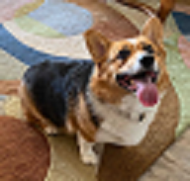

Image Resizing
Upsampling
64 px
128 px
192 px
64 px
128 px
192 px
Notes:
Another alternative is to rescale the feature map and convolve on that. If you look through code repositories featuring U-Nets, you’ll often find both rescaling and transposed convolution.

Slide 38
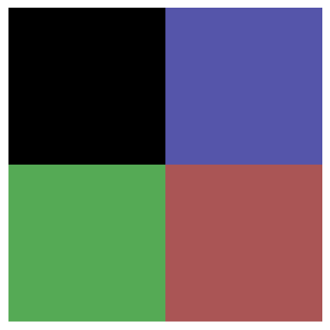
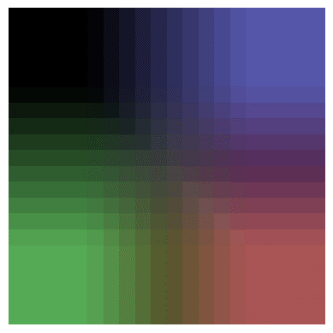
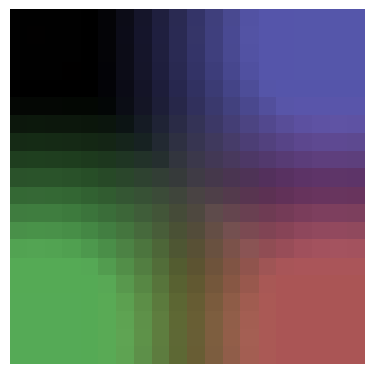
Image Resizing
Upsampling
Nearest
Bilinear
Bicubic
Notes:
The original image is 2x2. Let’s try scaling up to an image 10x bigger (so 20x20).
This is the effect of different scaling options. Nearest will copy the pixel values. Bilinear and Bicubic use different formulas to interpolate between the pixel values. Notice how bilinear is more square and bicubic is more round?

Slide 39
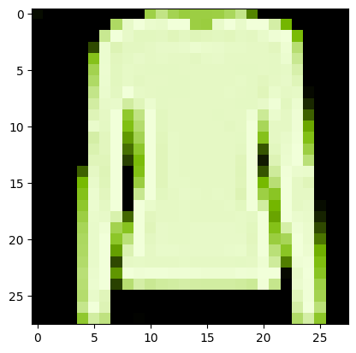
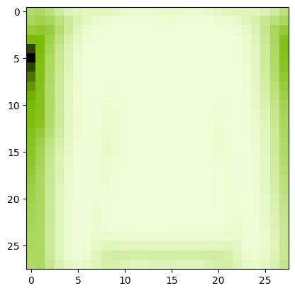
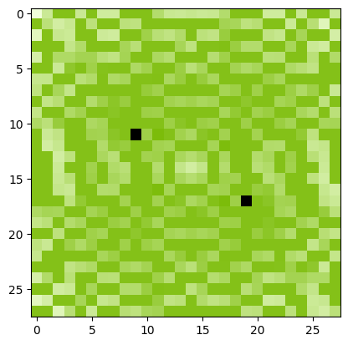
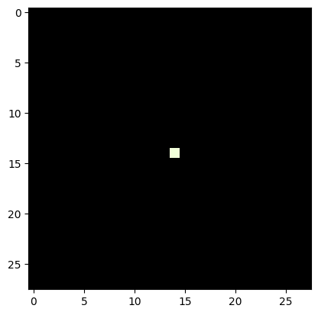
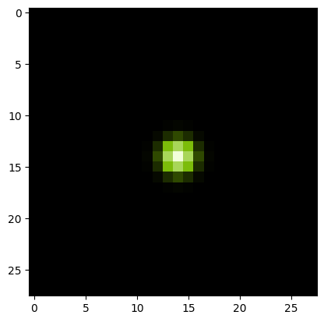
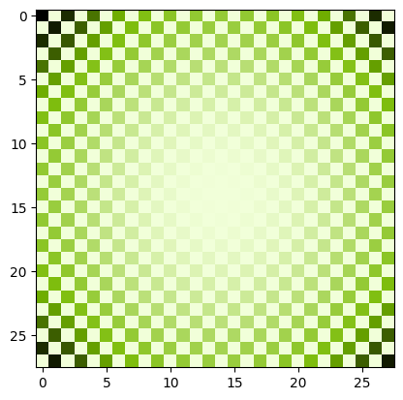
Deconvolution?
Same as Transposed Convolution?
Image
Convolved Image
FFT Convolved
Deconvolved Convolved Image
Point
Point Spread Function
FFT Point Spread Function
Notes:
Sometimes, people refer to transposed convolutional layers as deconvolution layers, but if you talk to an old school computer vision expert, deconvolution means something entirely different to them.
The goal of deconvolution is to undo a previous convolution. In this case, our convolution kernel is called he point spread function. We can take the fast Fourier Transform (FFT) of both the convolved image and the point spread function. We’ll then divide the transformed convolved image by the transformed point spread function. Take the reverse Fourier transform and tada! We have an approximation of the original image.
We don’t use Fourier Transforms much with computer vision neural networks, but it is a handy trick to know when working with audio.

Slide 40
Lab
Notes:
Ok, time for an experiment.

Slide 41
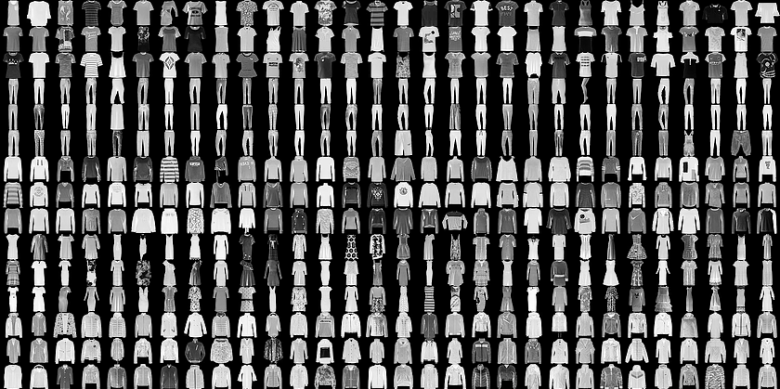
FashionMNIST
Convolutional Neural Network “Hello World”
Notes:
For this experiment, we’ll be using FashionMNIST. This dataset is a bunch of small black and white images that fall into ten categories of clothing.

Slide 42
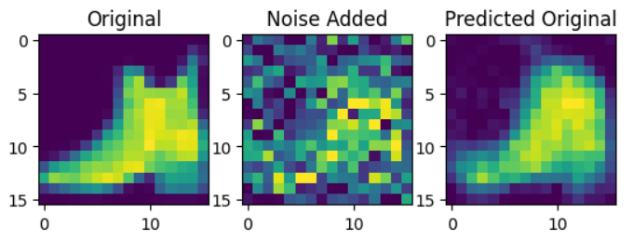
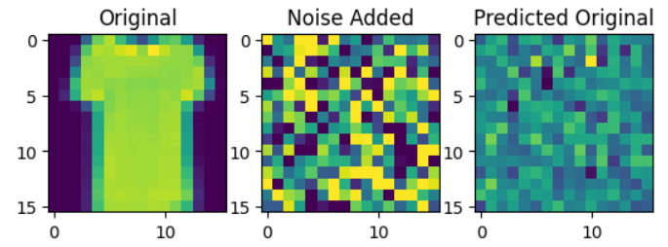

Hypothesis: Generate an image from Noise
Random Noise
Notes:
We’re going to add random noise to our images, and train a neural network to remove that noise. We will be using the normal distribution to sample our noise. If you are unfamiliar with this distribution, please see the appendix for this section.
If we then give the model purely random noise, as in, it is not added to any image, what would the model generate? We’re going to find out!

Slide 43
The Experiment
Feature Map
(Down0)
Down0
Copy
Feature Map
(Up2)
16 px
16 px
16 px
16 px
16 px
16 px
16 px
16 px
1 ch
16 ch
2 x 16 ch
1 ch
Feature Map
(Down1)
Down1 Copy
Feature Map
(Up1)
8 px
8 px
8 px
8 px
32 ch
2 x 32 ch
Feature Map
(Down2)
4 px
Latent Vector
Down2 Copy
Feature Map
(Up0)
4 px
64 ch
4 px
2 x 64 ch
128 ch
4 px
64 x 32 x 32
1024 features
Notes:
As mentioned before U-Nets are picky about their dimensions. So we’ve listed the dimensions of each feature map as it moves the U-Net we’ll be building.

Slide 44
Let’s get started!
Notes:
Ready to get building? Let’s get started!

Slide 45
Appendix:
The Normal Distribution
Notes:
If you’re not familiar with the normal distribution, that’s ok! Let me share with you a secret my math teachers passed on to me. Don’t worry so much about how a formula was derived. Focus instead on why it was created. Then it will be easier to remember when and how to use it.
So let’s dive into how the normal distribution was created. I’m not sure if this story is true, but it’s amusing and makes sense, so I’m going to tell it anyway.

Slide 46
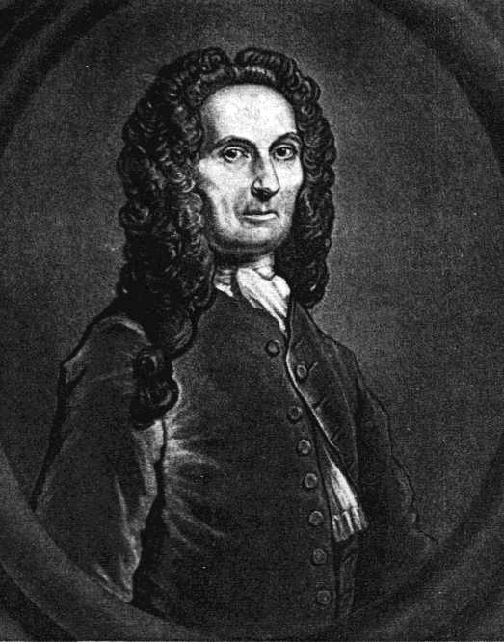

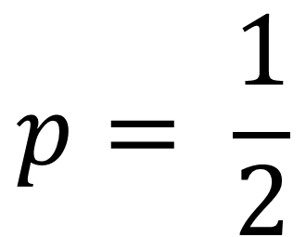
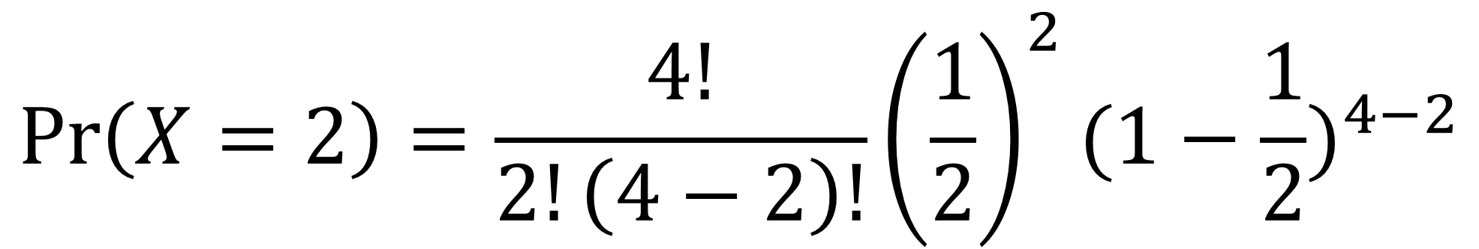
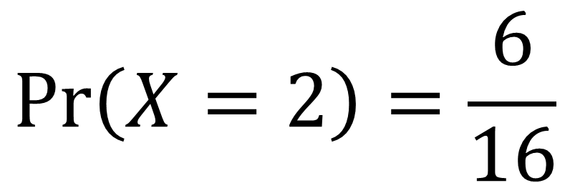
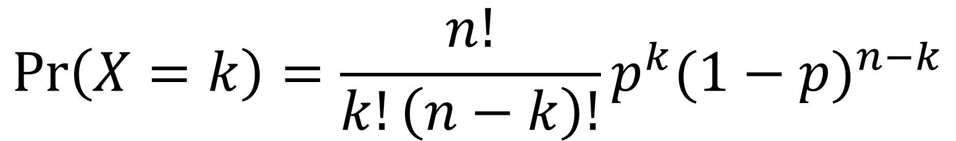
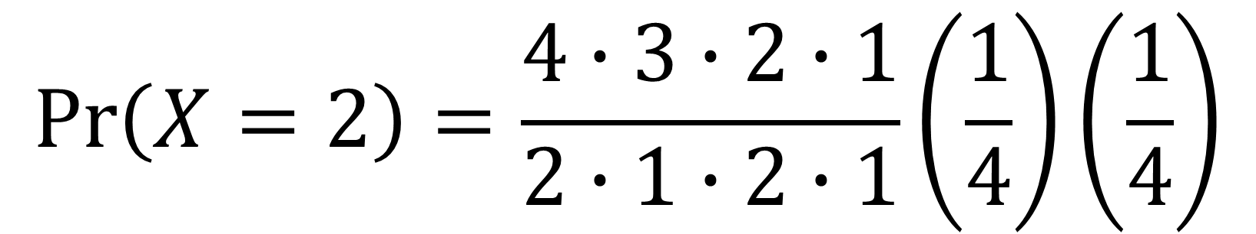
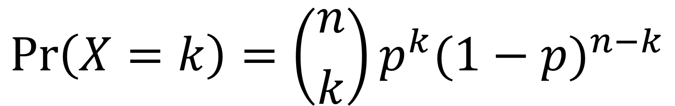
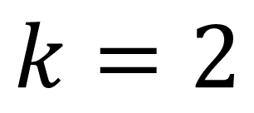
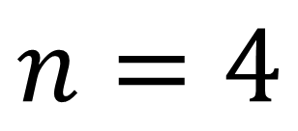
De Moivre
From Coin Flips to Bells
$$p= \frac{1}{2}$$
$$\operatorname{Pr}\left(X=k\right)=\left({n \atop k}\right)p^{k}{(1−p)}^{n−k}$$
$$n=4$$
$$\operatorname{Pr}\left(X=k\right)=\frac{n!}{k!\left(n−k\right)!}p^{k}{(1−p)}^{n−k}$$
$$k=2$$
$$\operatorname{Pr}\left(X=2\right)=\frac{4!}{2!\left(4−2\right)!}{\left(\frac{1}{2}\right)}^{2}{(1−\frac{1}{2})}^{4−2}$$
$$\operatorname{Pr}\left(X=2\right)=\frac{4∙3∙2∙1}{2∙1∙2∙1}\left(\frac{1}{4}\right)\left(\frac{1}{4}\right)$$
$$\operatorname{Pr}\left(X=2\right)=\frac{6}{16}$$
A weighted coin flipping through the air like a cartoon
Notes:
De Moivre was a famous French mathematician in the late 1700’s. Gamblers found out of his mathematical prowess and kept asking him to calculate what are the chances they would get at least x heads in y coin flips.
This is a doable, but tedious calculation. Let’s say we flip 4 coins (n) and want to find out the chance we get 2 heads (k). The chance we get heads (p) is ½.
We can plug in these numbers…
And get a 6 out of 16 chance, or 37.5% chance.
But if we want to find the chance to flip at least 2 heads, we also must calculate the chance for 3 heads, and the chance for 4 heads.

Slide 47
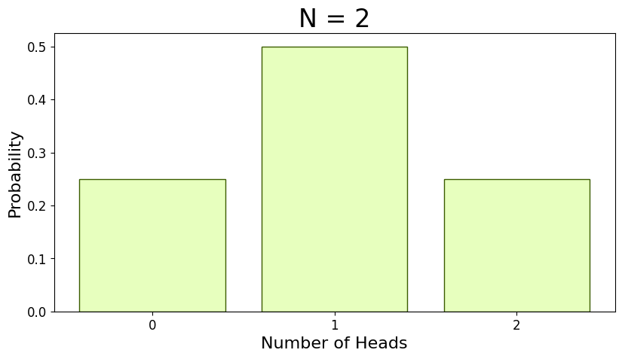
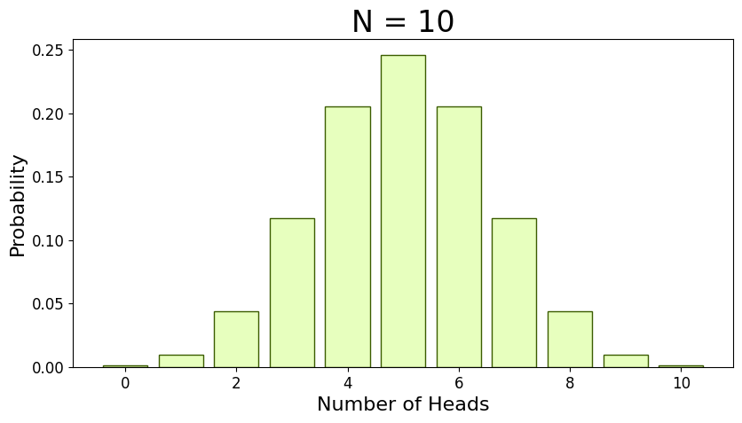
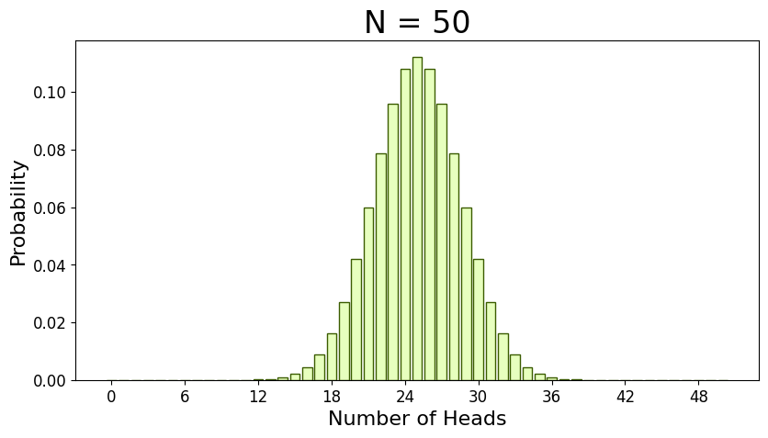
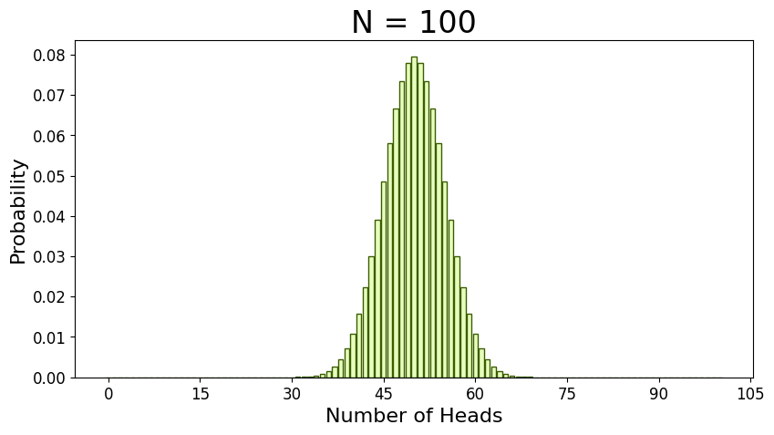
De Moivre
From Coin Flips to Bells
Notes:
This was in the 1700’s so de Moivre was doing these calculations by hand. No computers and no calculators. The process is a little annoying with a small number of coin flips, extremely annoying with large number of coin flips.
As de Moivre was working on this, he noticed when n gets large, the probability distribution takes on a bell shape. He thought if he could create an approximation, he wouldn’t have to keep doing this annoying calculation.

Slide 48
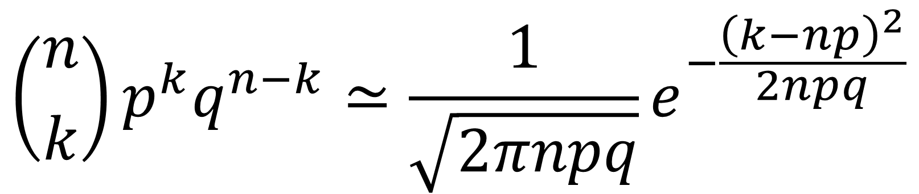
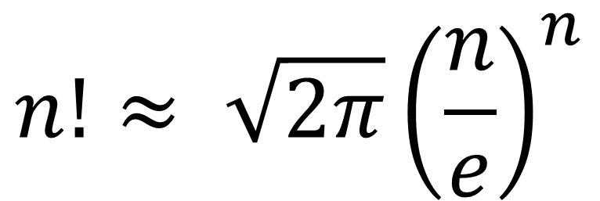


De Moivre
From Coin Flips to Bells
$$\operatorname{Pr}\left(X=k\right)=\left({n \atop k}\right)p^{k}{(1−p)}^{n−k}$$
$$\operatorname{Pr}\left(X=k\right)=\frac{n!}{k!\left(n−k\right)!}p^{k}{(1−p)}^{n−k}$$
$$n!≈ {\sqrt{2π}\left(\frac{n}{e}\right)}^{n}$$
$$\left({n \atop k}\right)p^{k}q^{n−k}≃\frac{1}{\sqrt{2πnpq}}e^{−\frac{{\left(k−np\right)}^{2}}{2npq}}$$
$N\left(x;μ,σ^{2}\right)=\frac{1}{σ\sqrt{2π}}e^{−\frac{1}{2}{\left(\frac{x−μ}{σ}\right)}^{2}}$
A weighted coin flipping through the air like a cartoon
Notes:
The mathematician James Stirling knew that de Moivre was working on this and sent a letter. He discovered when n! is sufficiently large, it can be approximated with this equation.
De Moivre took that equation and derived this one. After a few other mathematicians added their input and…
The normal curve was born!
(q in this context is 1 – p. Another shorthand for tedious hand-written math)
The normal curve was modified to have two important parameters. $μ$ (mu, sounds like mew the Pokémon) is the model mean, or as it’s also called, the average. It is the center of the normal curve. Notice where $μ$ is, there is n times p in the previous equation? The number of coin flips times the probability of landing heads would give you the average number of heads for n coin flips. This relatively small term in this large equation is responsible for centering the entire distribution.
On the other hand, $σ$ (sigma) is the standard deviation and represents the spread of the distribution, or how much it is stretched or squished horizontally. Comparing it to the previous equation sigma represents $\sqrt{npq}$, but only conceptually. De Moivre was looking for a solution for a finite number of coin flips. We can think of the normal curve as an infinite number of coin flips!

Slide 49





De Moivre
From Coin Flips to Bells
$N\left(x;μ,σ^{2}\right)=\frac{1}{σ\sqrt{2π}}e^{−\frac{1}{2}{\left(\frac{x−μ}{σ}\right)}^{2}}$
$μ=mean, a.k.a. average$
$$σ=standard devaition, a.k.a. spread$$
$$z=\frac{x −μ}{σ}$$
Notes:
So what would that mean?
Instead of calculating the probability, it calculates the probability density. If we flip an infinite number of coins, the chance to flip exactly 10 coins is 0. But, we can use this to calculate the chance of flipping at least 10 heads. Back in the day, people would calculate this using the integral, but it became so useful, the results were precalculated into a table of values, so you don’t need calculus to use this. These days the computer takes care of everything.
The bands highlighted in the picture are a famous set of bands. 68% of data samples from a normal distribution will within 1 standard deviation of the mean. So, when we sample our noisy pixels, 63.7% of them are going to have a value between -1 and 1. 95% of pixel values will be between -2 and 2. And 97.7% of the pixel values will be between -3 and 3.
When something is “normalized” using the normal distribution, that means it is fit to what’s called a “standard normal distribution”. That’s when the mean is 0 and the standard deviation is 1. The z score is a transformation of a variable to its corresponding standard normal distribution equivalent. For many images, the default pixel range is between 0 to 255 or 0 to 1. In the lab, we will convert the pixel values to -1 to 1 so it aligns with the noise we will be generating using the standard normal distribution.
In the lab, for each of our pixel values in our image, we will be selecting values based on this standard normal distribution, and this will be key to the theory behind diffusion models.

